Slide 1
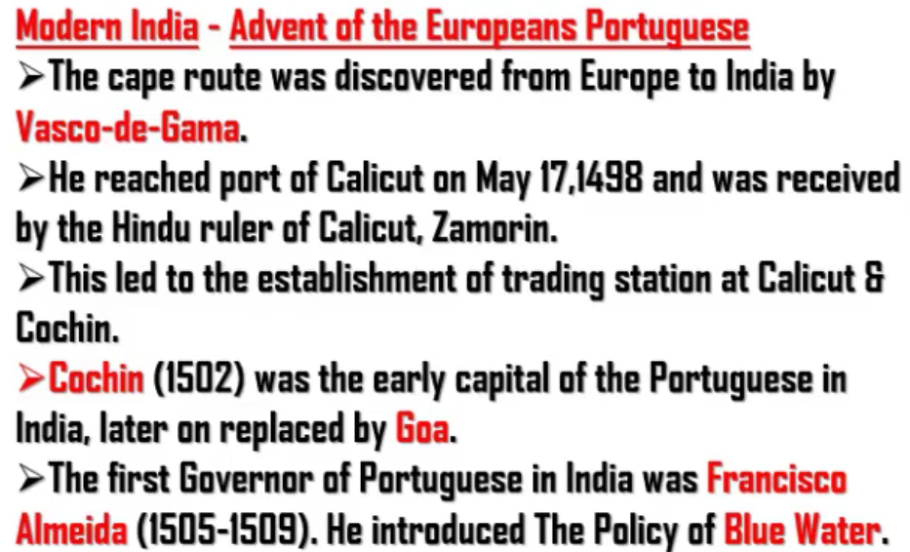
Vasco-de-gama started from Lisbon in Portugal.
Goa was controlled by Portuguese even when India got independence in 1947.
Goa later got independence from Portugal and not British.
Blue Wter – Trade should happen only between Portugal.

Slide 2
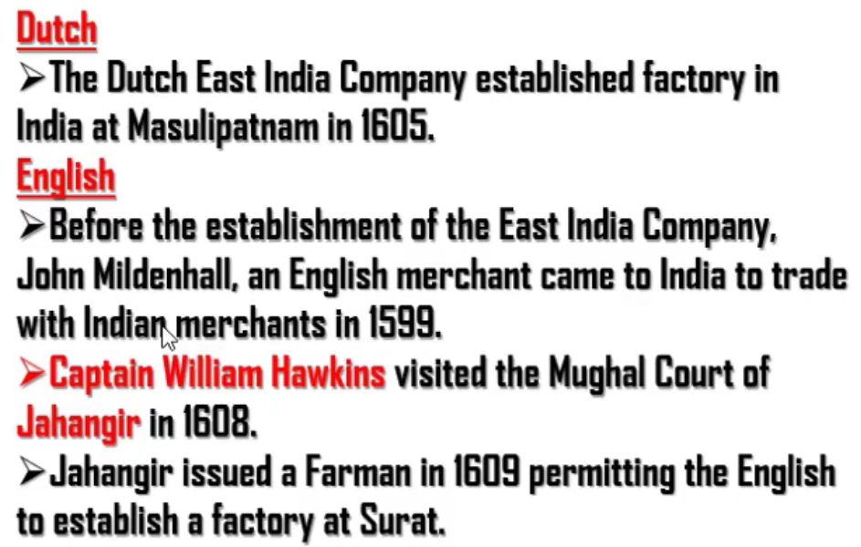

Slide 3
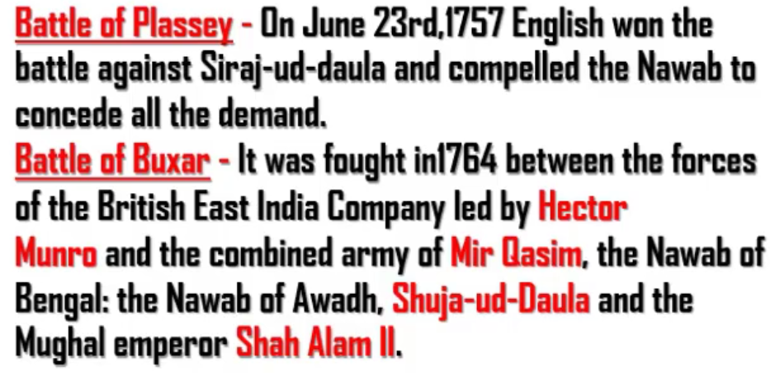
British got full power in 1757. They ruled till 1947 (190 years) (approx. 200 years or 2 centuries)
(Hector Munro) v/s (Mir Qasim - Nawab of Bengal, Shuja-ud-Daula - Nawab of Awadh, Shah Alam II - Mughal emperor)
Note : Shiraj-ud-Daula (was Nawab of Bengal) is different from Shuja-ud-Daula (was Nawab of Awadh)

Slide 4
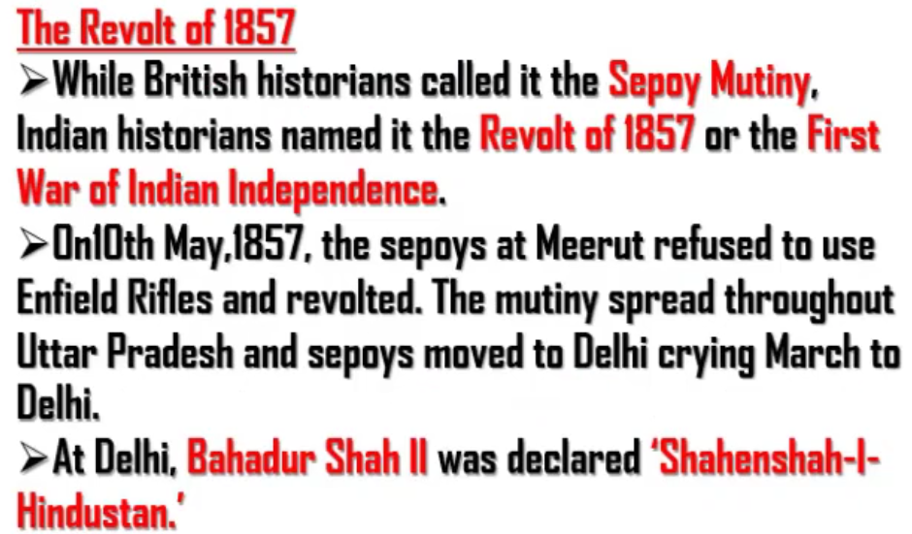
Mangal Pandey (Uttar Pradesh) started Sepoy Mutiny or Revolt of 1857 by shooting his senior.
Sepoy Mutiny or Revolt of 1857 was also supported by Jhansi kingdom under Rani Lakshmi Bhai.
Tantya Tope also supported sepoy mutiny or Revolt of 1857.
Sepoy Mutiny or Revolt of 1857 Main theme: Refusing to lick flesh of animals (Enfield Rifles)
“Shahenshah-I-Hindustan” mean “Ruler of Hindustan”
Bahadur Shah II (Last Mughal ruler also called as Bahadur Shah Zafar because of his pen)
But sepoy mutiny or Revolt of 1857 failed because:
The rulers in India were fighting against themselves.
Due to above reason there didn’t exist a mass leader who could lead the revolt effectively.

Slide 5
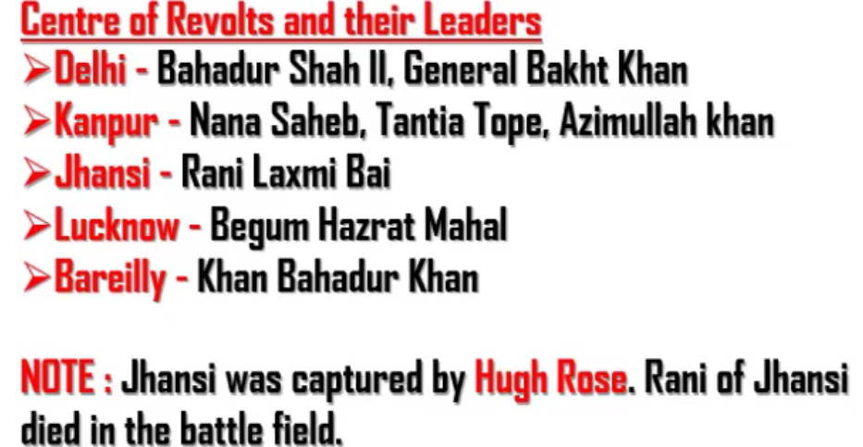
All these people were not united. They fought separately. Due to this, the revolt failed.
Hugh Rose killed Jhansi in the battle.

Slide 6
